Slide 1
Becoming Julia morgan
A play by
Belinda taylor
Directed by starring
Linda Wilson mara purl
Presented by the Monday club
San luis Obispo, California
October 2017

Slide 2
Cast
Julia Morgan
William Randolph Hearst
Jerry Mac
Irene Mac
Avery Morgan
Eliza Morgan
Charles Morgan
Phoebe Hearst & Cecile
Maybeck & Chaussemiche
Beth & Jenny
John Galen Howard
Jake
Vesta
Janus
Charlie Chaplain
Mara Purl
Christopher Law
Jeff Walters
Wendy Marie Martin
David Rosenblatt
Tara Brinkman
Dan Murry
Wendie Marie Martin
Dan Murry
Corina Sullivan
Christopher Law
David Rosenblatt
Corina Sullivan
David Rosenblatt
Wendy Marie Martin

Slide 3
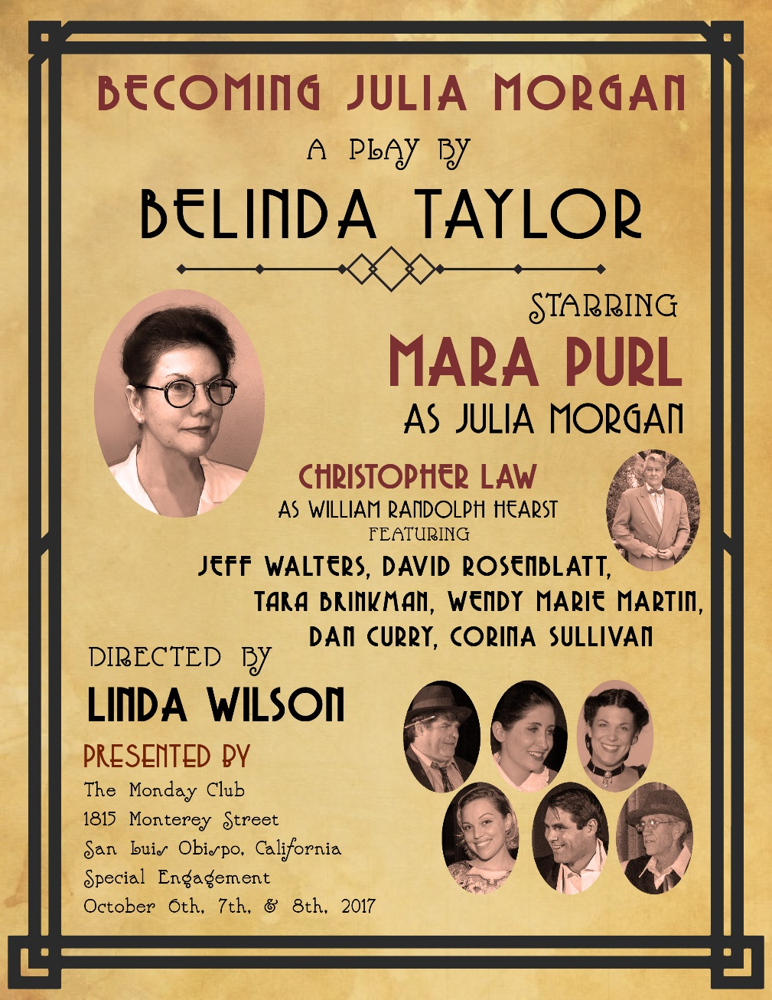

Slide 4
Act I

Slide 5
Prelude
Julia Morgan explains the Golden Ratio,
the basis of her architectural philosophy

Slide 6
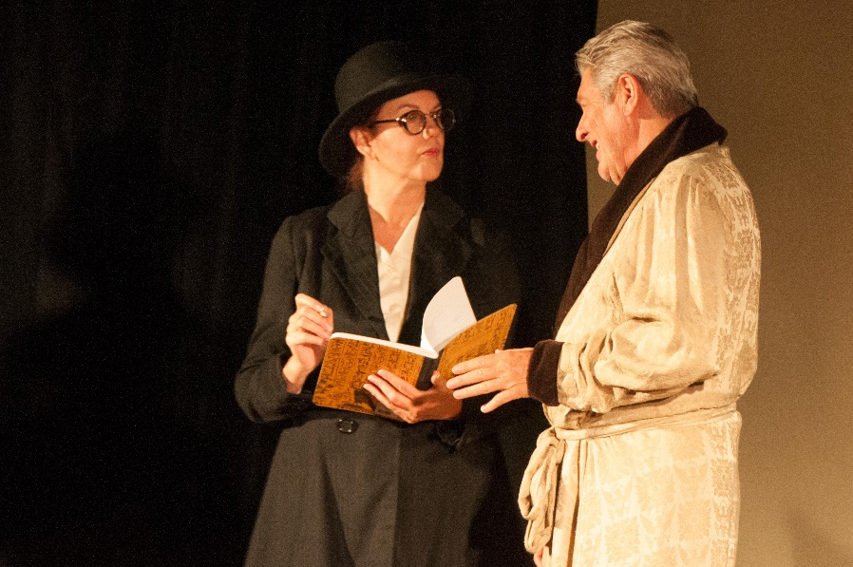
Scene i 1933
At San Simeon . . .
Julia meets with
Jake the gardener
. . . And with her employer William Randolph Hearst

Slide 7
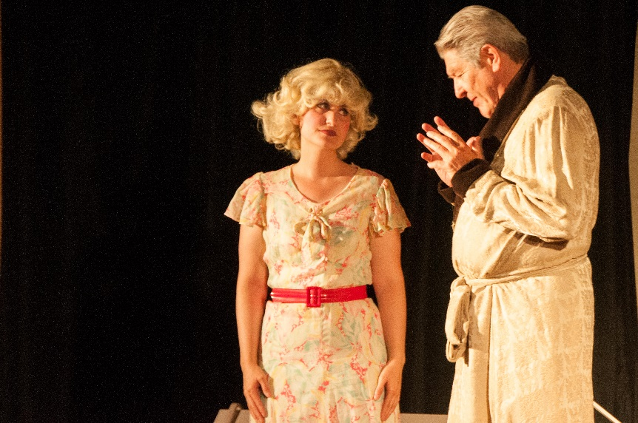
Scene i 1933
Hearst’s close friend,
glamorous actress
Marion Davies,
Is companion and assistant with plans and parties
at San Simeon
. . . She suggests where
Hearst Newspapers journalist
Jerry Mac
may find Julia
to conduct his assigned interview

Slide 8
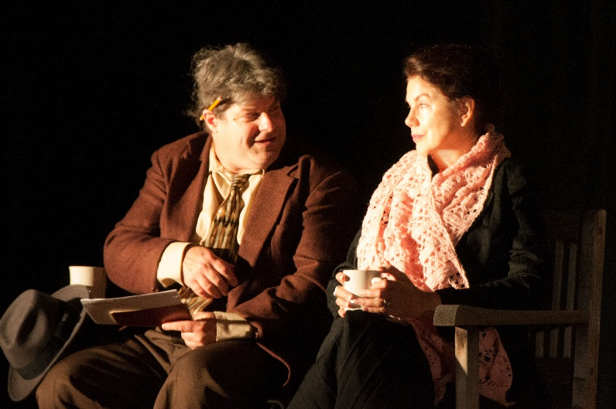
Scene ii 1933
Julia, on her weekly train ride from San Francisco to San Luis Obispo, is skeptical of Jerry Mac’s intentions, irritated by his presumption . . .
… and would rather be
left alone!

Slide 9
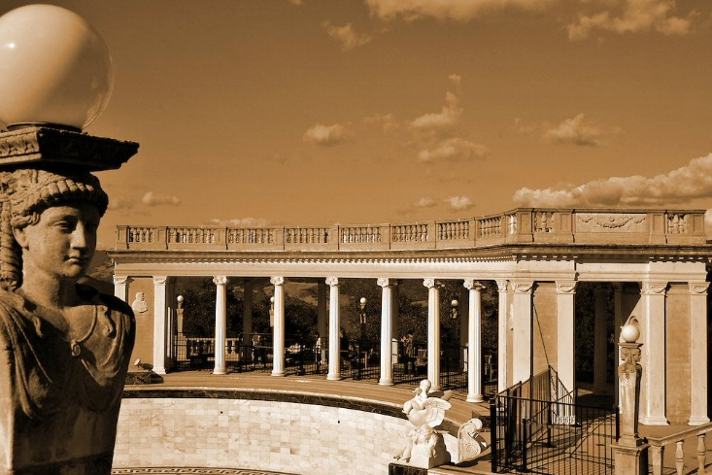
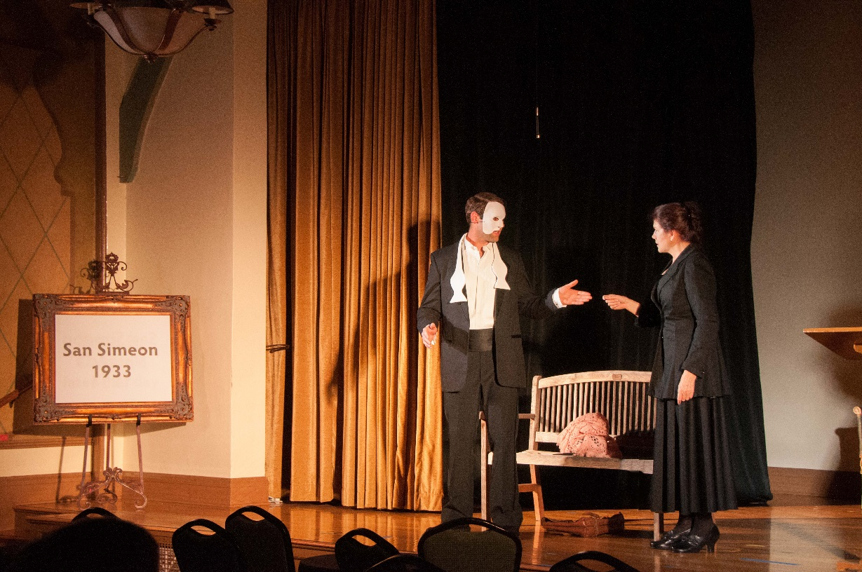
Julia, en route to San Simeon, where she’s building the Neptune Pool,
falls asleep and dreams…
…a nightmare that
Janus, Roman god of architecture, has come to judge her, the first woman licensed as an architect in California, preventing her
from joining the
Pantheon of Architects

Slide 10
Julia, en route to San Simeon, where she’s building the Neptune Pool,
falls asleep and dreams…
…a nightmare that
Janus, Roman god of architecture, has come to judge her, the first woman licensed as an architect in California, preventing her
from joining the
Pantheon of Architects

Slide 11
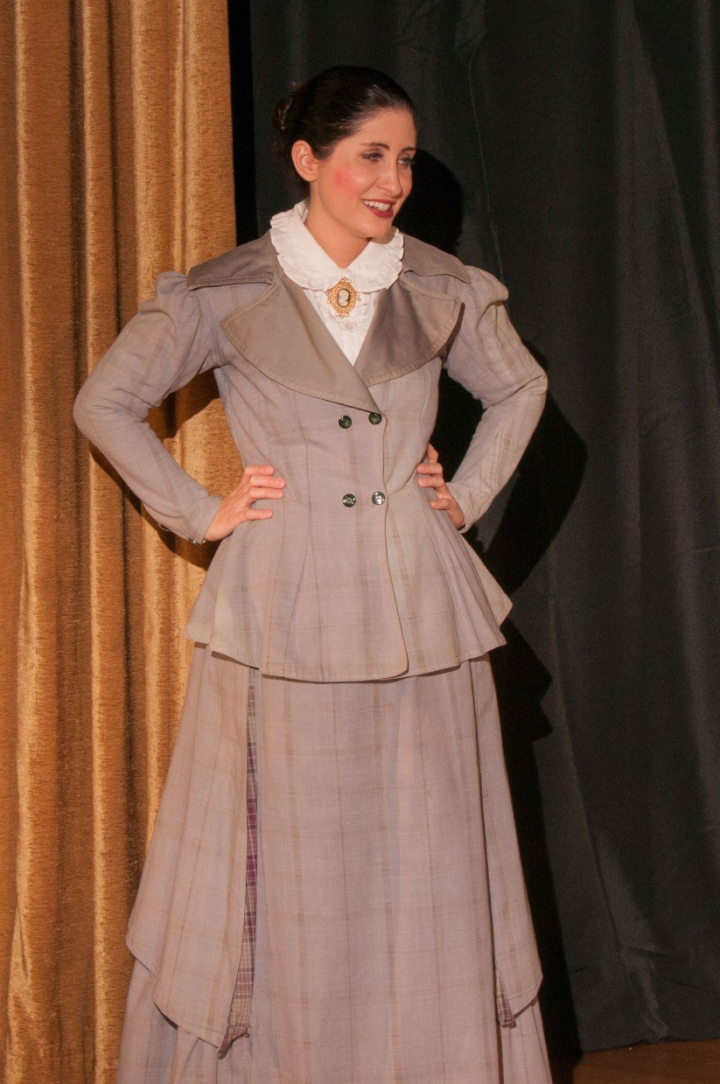
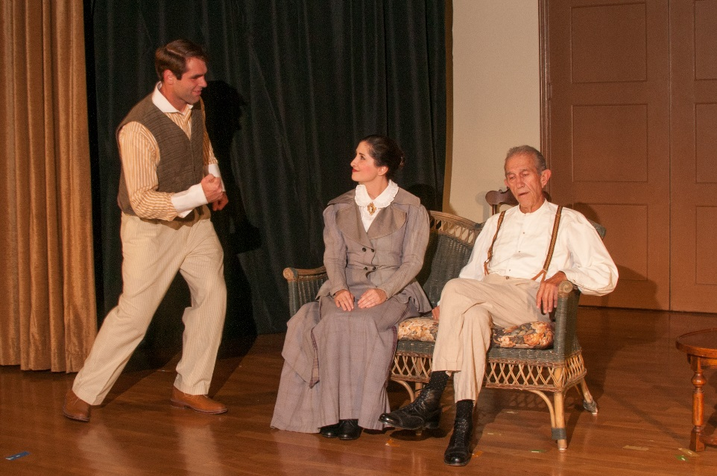
Scene v 1890
Julia’s family discusses her future. Father assumes she’ll be a debutante. Mother declares, no, she shall get an education. Brother Avery offers to see her safely to and from college at Berkley.

Slide 12
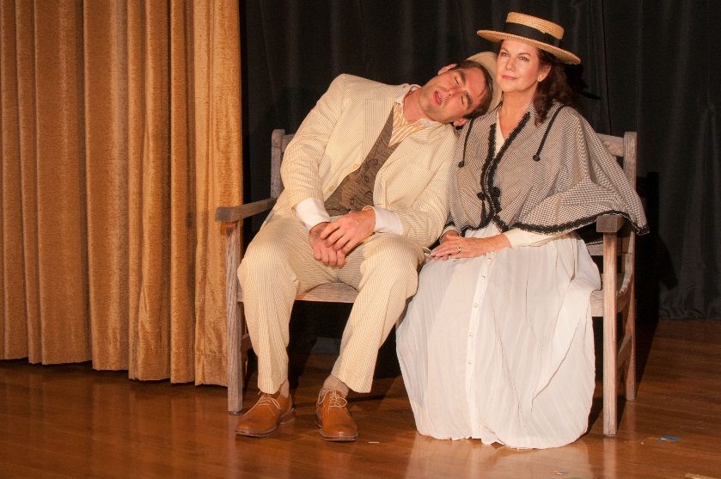
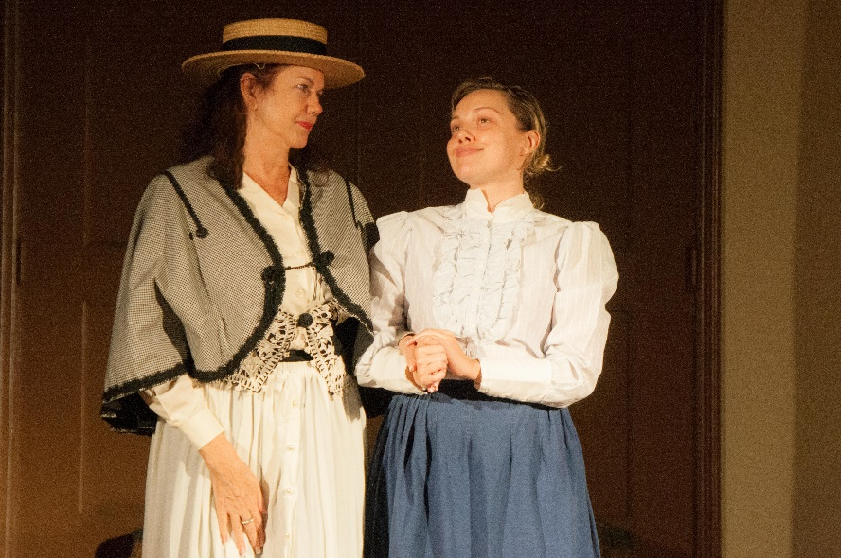
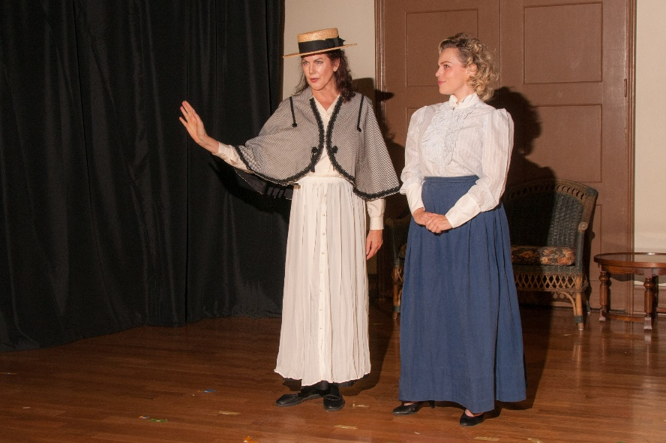
Scene vi 1890
Julia en route to Berkley
with Avery,
via horse-drawn carriage…
And with her friend Beth, protesting the lack of on-campus housing for women

Slide 13
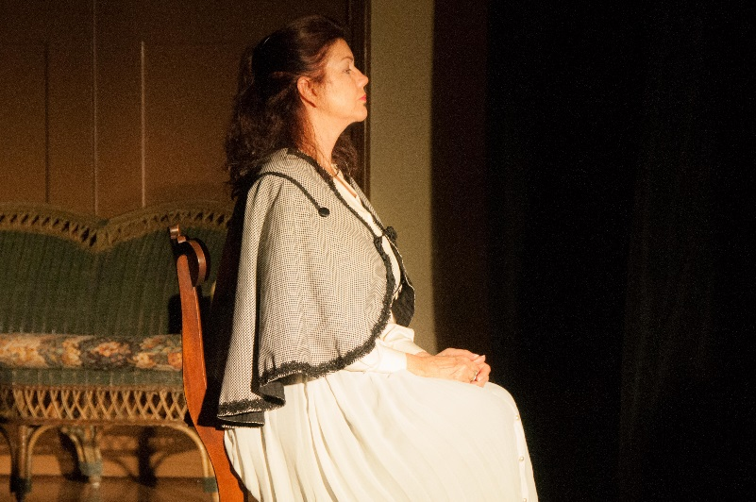
Scene vii
Julia, the attentive student, is perhaps too eager to answer every question posed by her teacher, Professor Maybeck

Slide 14
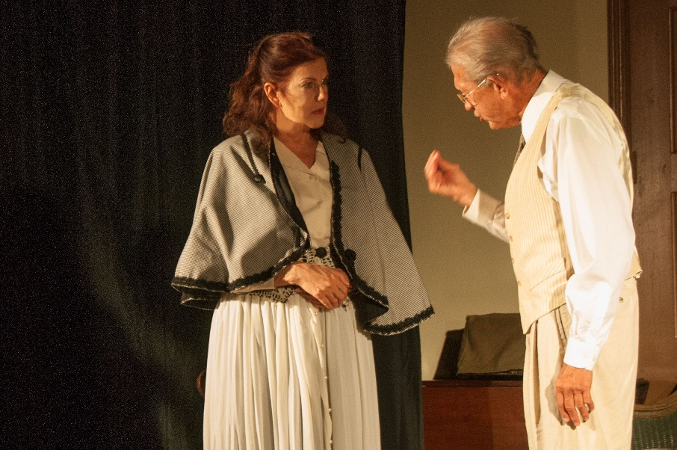
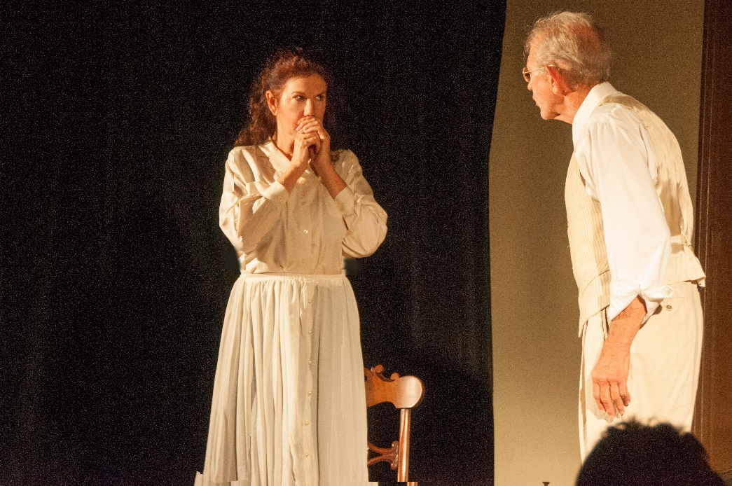
Scene viii 1895
After graduation, she visits her mentor who tells her she MUST take the entrance exam at the Ecole des Beaux Arts
She dares to hope
her most fervent dream
might come true…

Slide 15
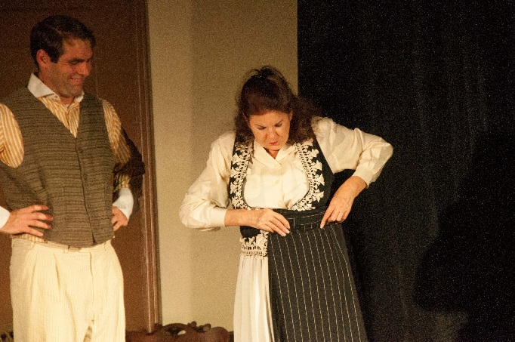
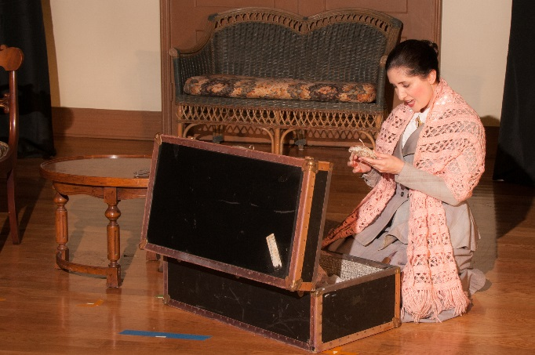
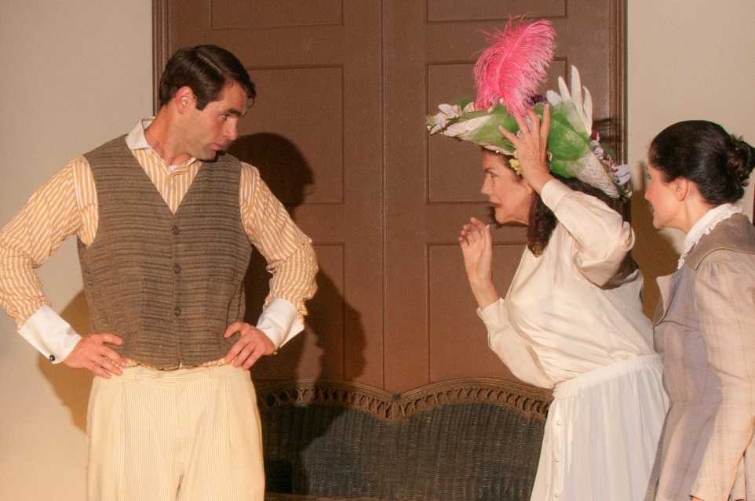
Scene ix
Julia borrows pants from her brother, so she’ll be able to climb scaffolding …
Mother helps her pack, adding her favorite pink scarf…then presents her with THE hat, whether she wants it or not!

Slide 16
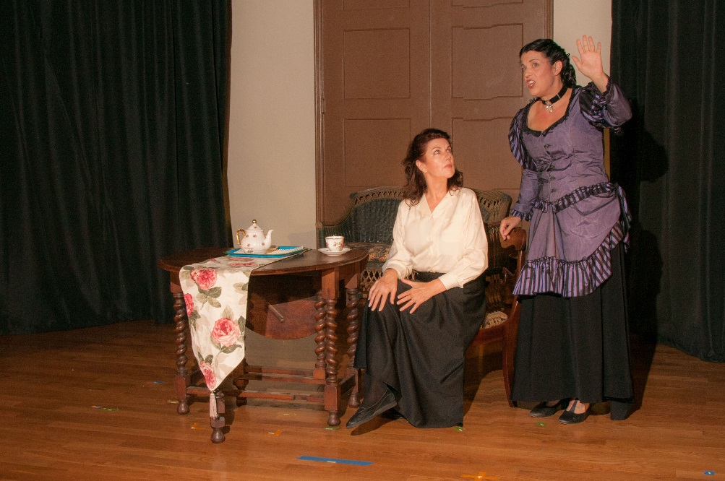
Scene x 1896
Cecile, Julia’s new friend in Paris, warns that L’Ecole will do all it can to prevent her from passing their exam!
Scene xi
Meanwhile, Julia works for the mentor and architect Chaussemiche in Paris

Slide 17
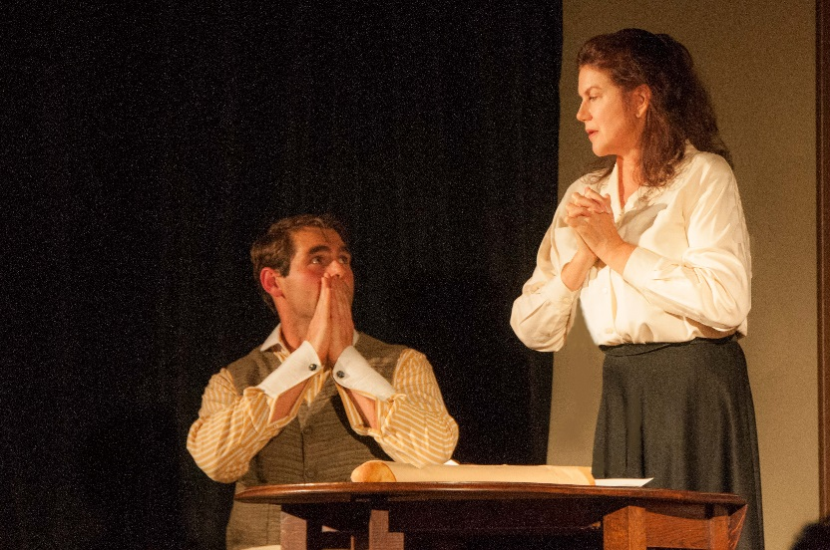
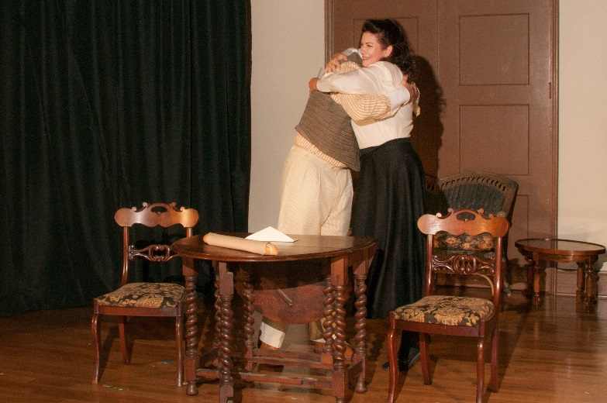
Scene xii 1896
Julia, too nervous to open the letter, asks her brother Avery to open it . . .
Scene xi
Yes! She is the first woman to pass the rigorous exam to enter L’Ecole des Beaux Arts!

Slide 18
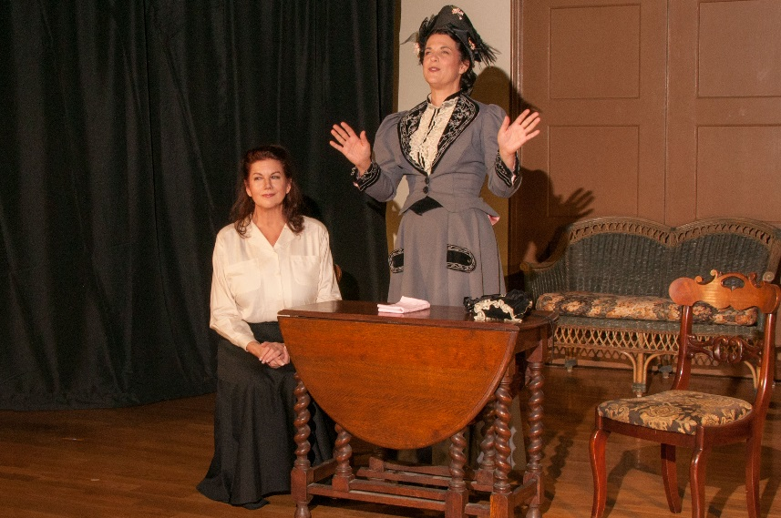
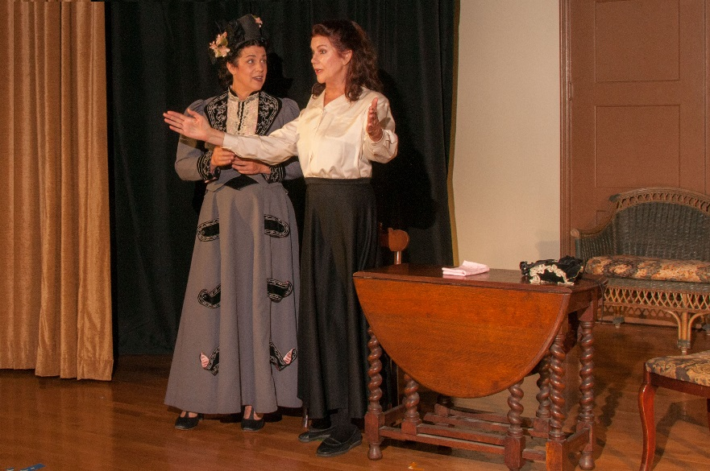
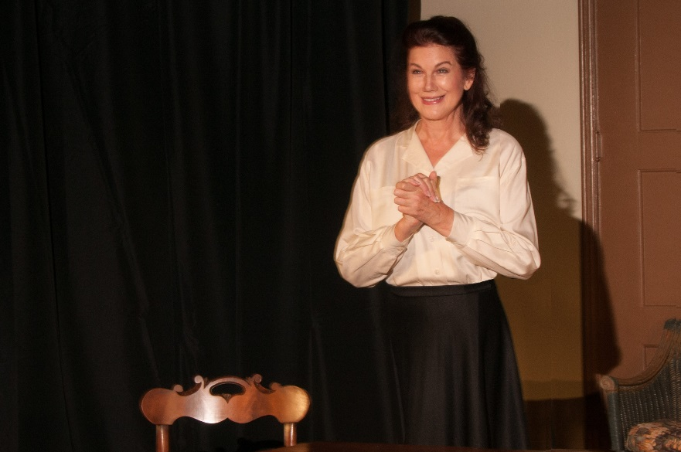
Scene xiii 1898
A fateful first meeting with Phoebe Hearst, board member of the YWCA, who wants to hire the brand new architect to design & build suitable housing for women. Julia immediately has ideas . . . And is jubilant at this stellar opportunity!

Slide 19
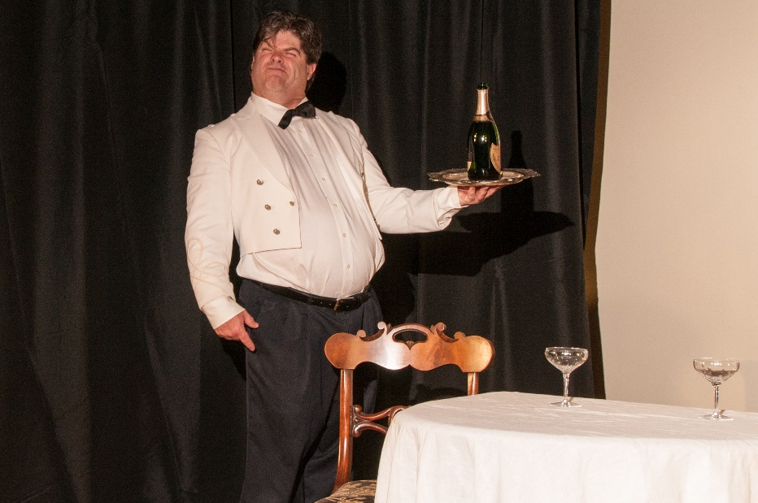
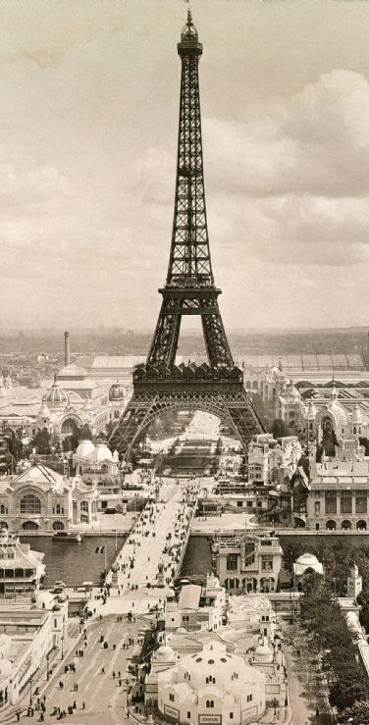
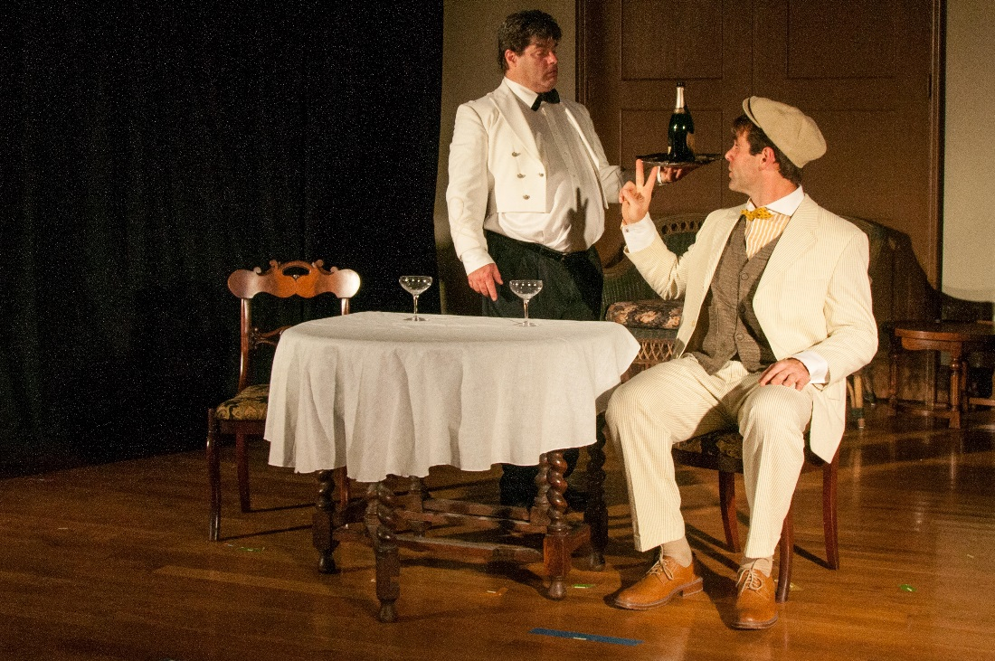
Scene xiv 1899
New Year’s Eve in Paris.
Avery, awaiting Julia’s arrival, orders two glasses of champagne from a surly French waiter . . .

Slide 20
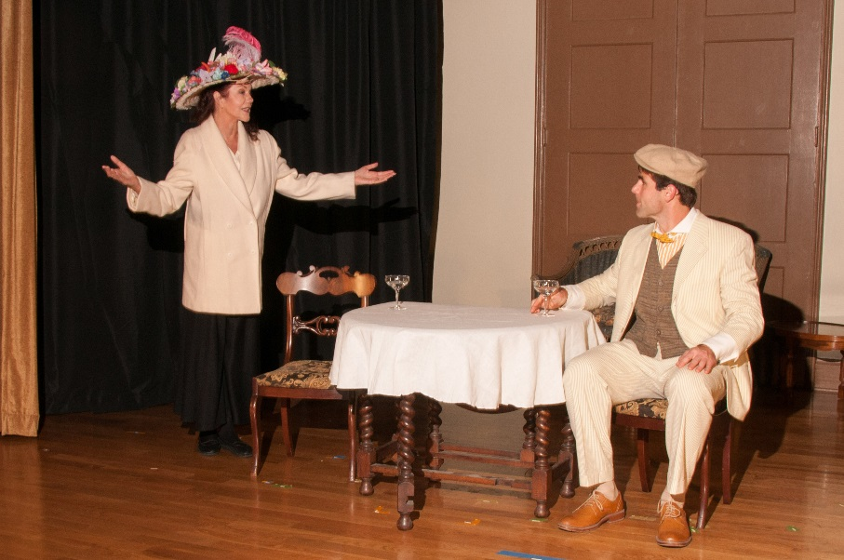
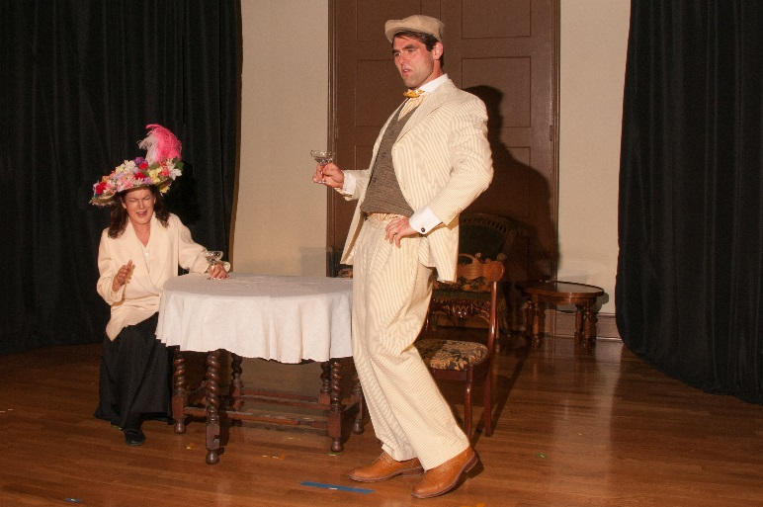
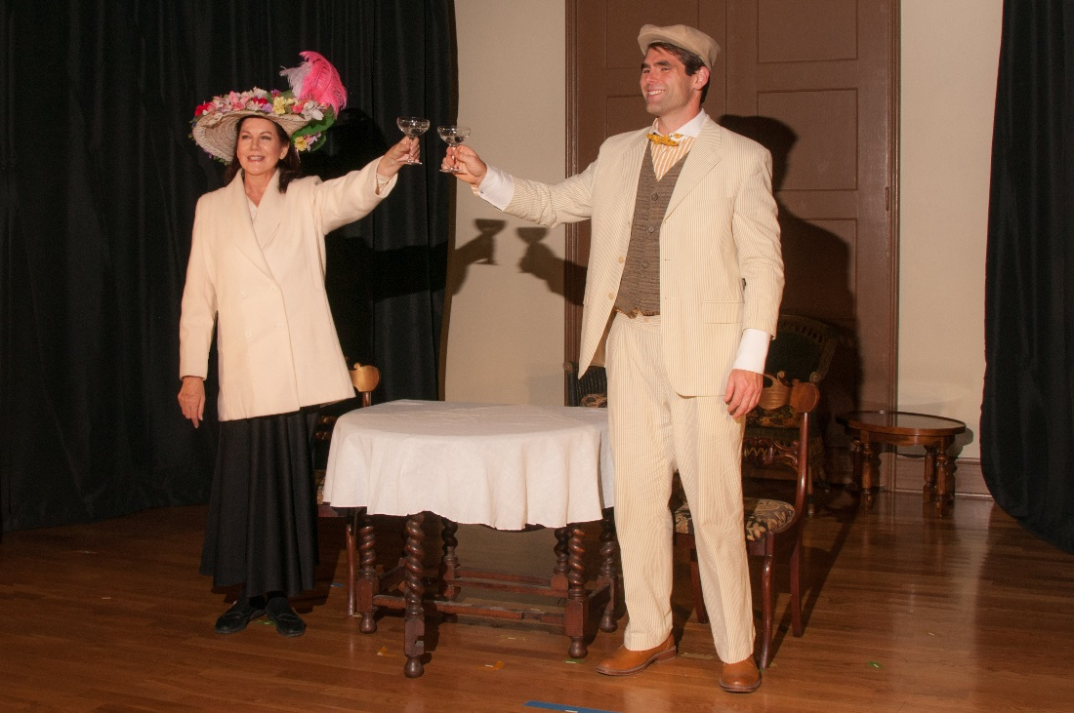
Scene xiii 1898
Julia arrives in THE hat . . .
The two get tipsy, Julia in fits of laughter at Avery’s antics . . .
Then they toast
to the
New Century!

Slide 21
Act II

Slide 22
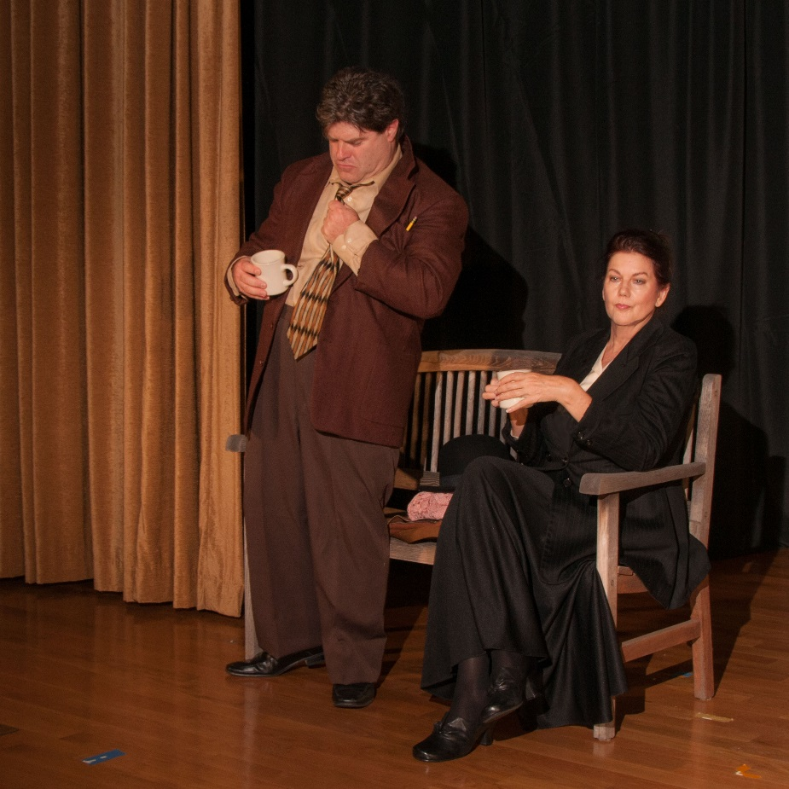
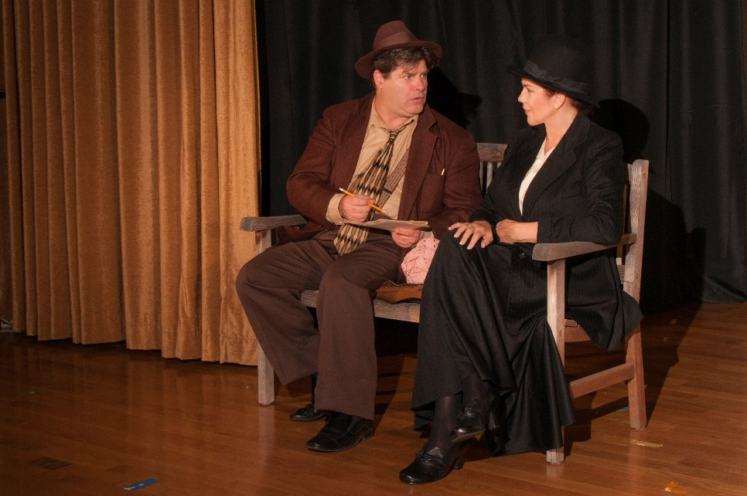
Scene xi 1933
Reporter Jerry Mac continues to make his case, while plying Julia with spiked coffee . . .
. . . Until she begins to believe he’ll write about her work, not about her, so she agrees, he shall write his book. . .

Slide 23
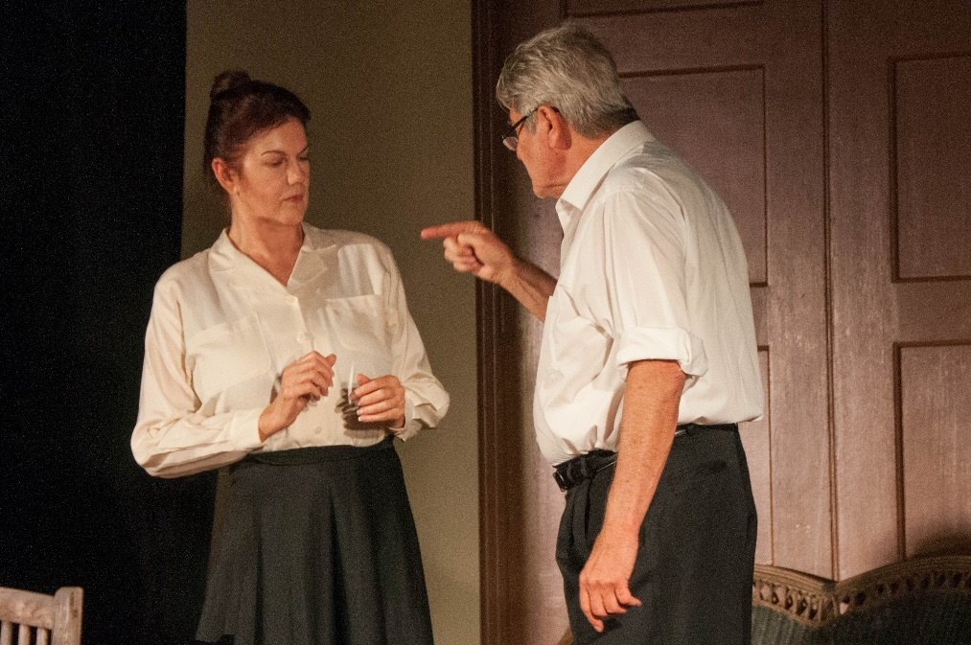
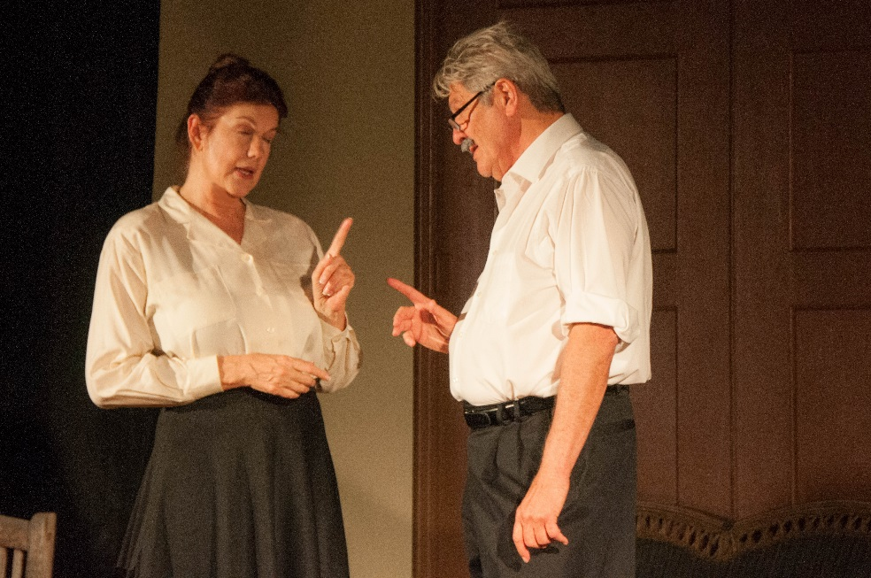
Scene i b 1902
A first job, working for the well-known architect John Galen Howard, who is more bossy than appreciative.
She rescues his Greek Theatre project,
is called an ingrate, and resigns, ready to establish her own firm.

Slide 24
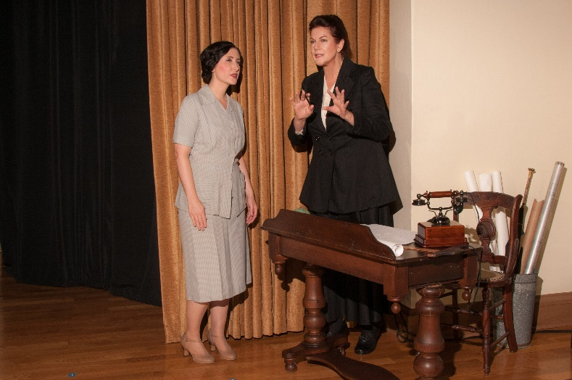
Scene ii 1926
Julia at her San Francisco Architectural Firm with her assistant Elizabeth, discussing a client project
She rescues his Greek Theatre project,
is called an ingrate, and resigns, ready to establish her own firm.
Avery, now her driver,
barely has time for his newspaper between chauffeuring her to job sites.

Slide 25
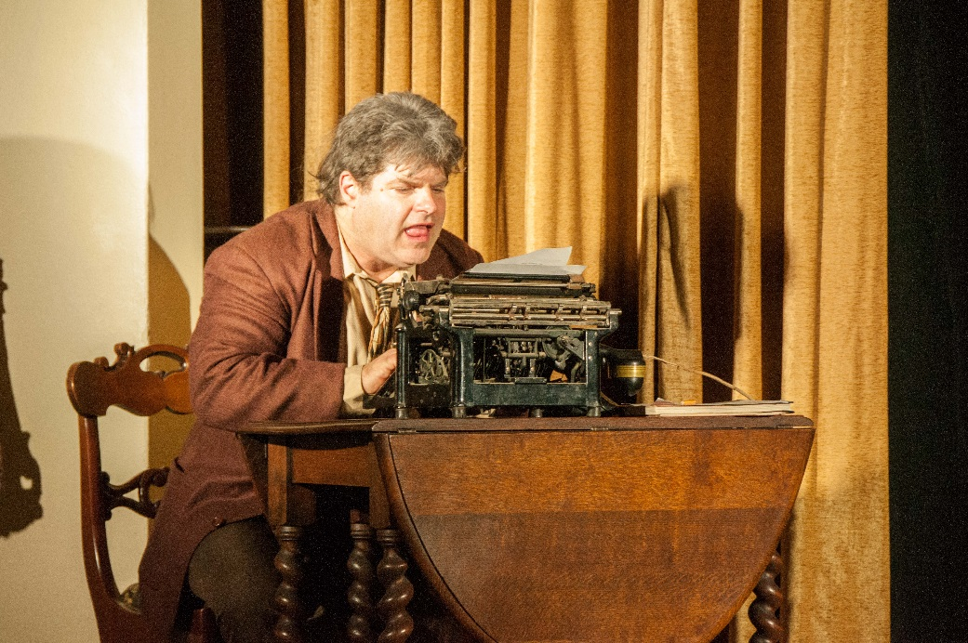
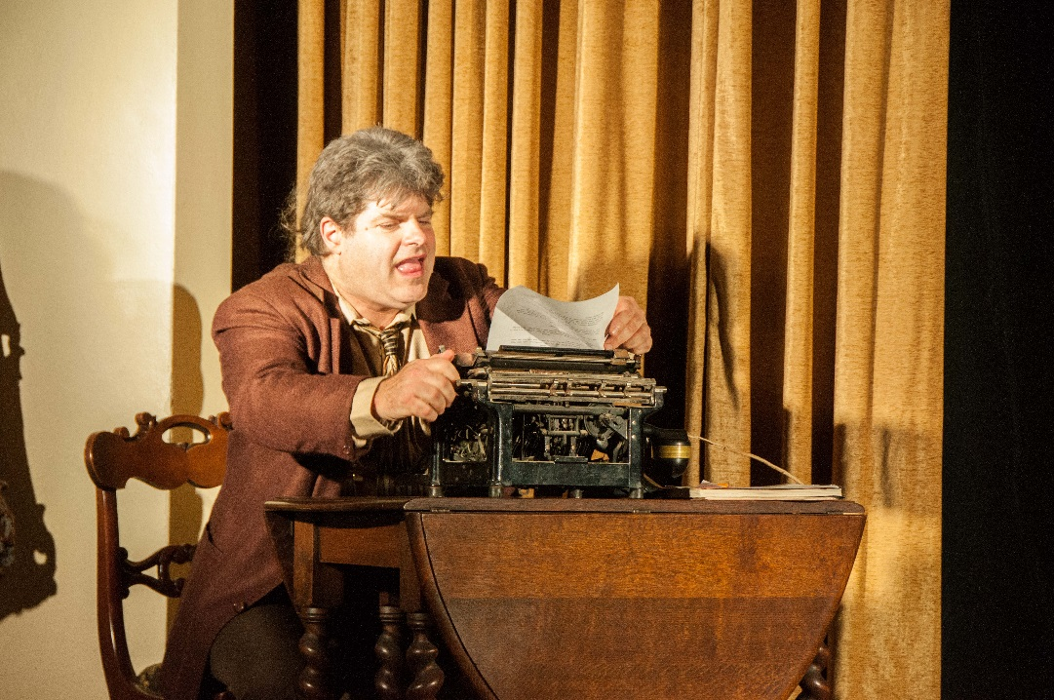
Scene iii 1933
Jerry Mac works
on his book . . .
The biography of
Julia Morgan

Slide 26
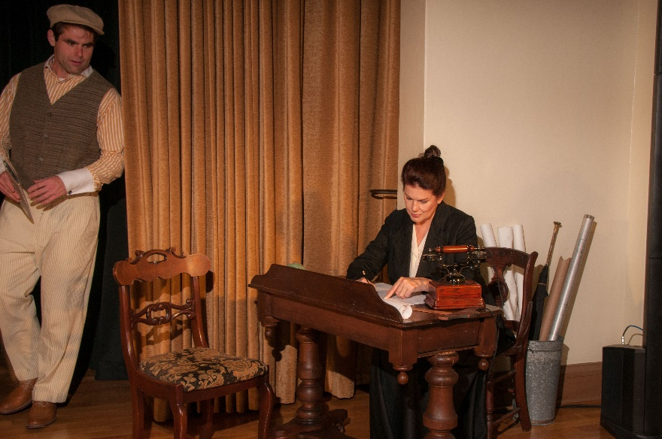
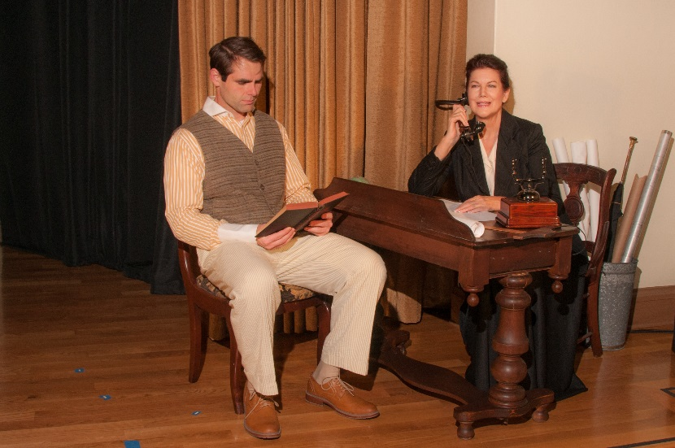
Scene v 1928
Avery arrives as Julia works. She calls WR Hearst to check on progress at San Simeon, and discuss details.
As the call continues,
Avery begins to nod off . . .

Slide 27
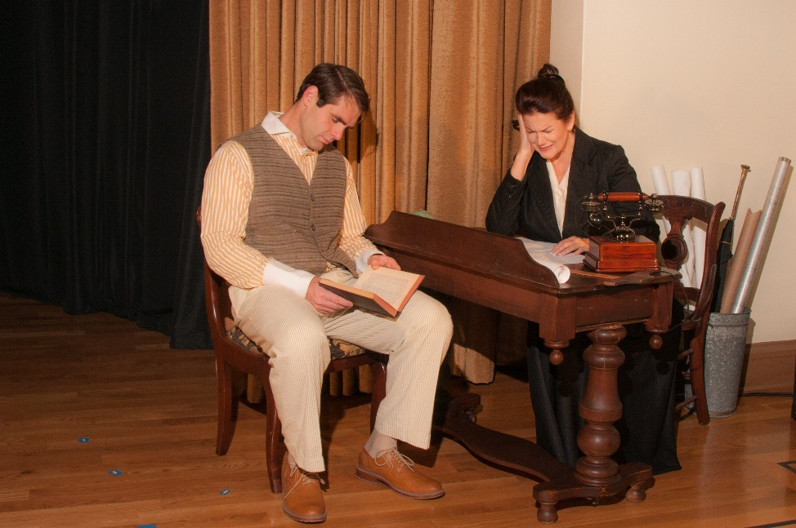
Scene v 1928
But when she shrieks with pain, he wakes with a start, concerned about her ongoing ear torment

Slide 28
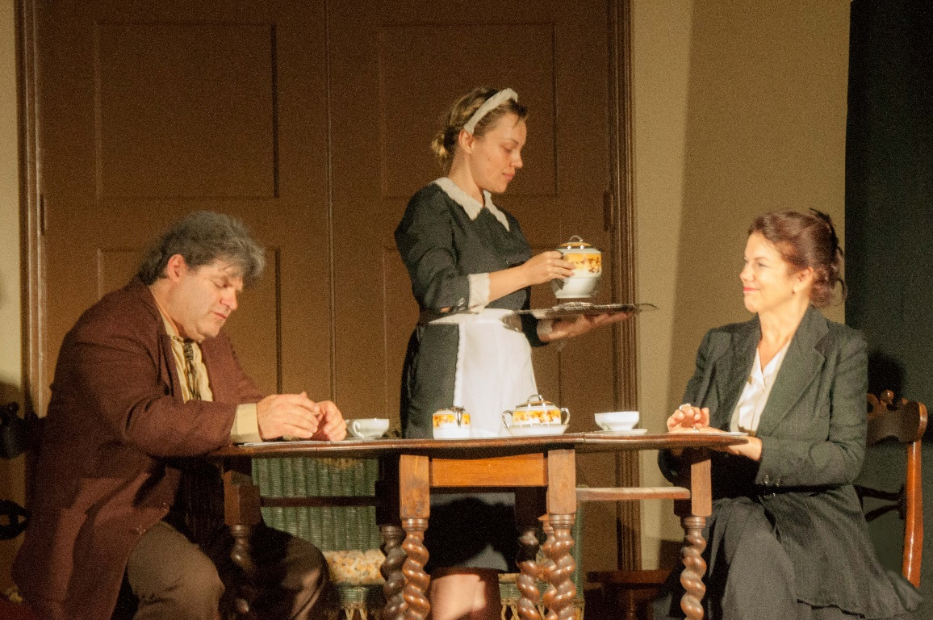
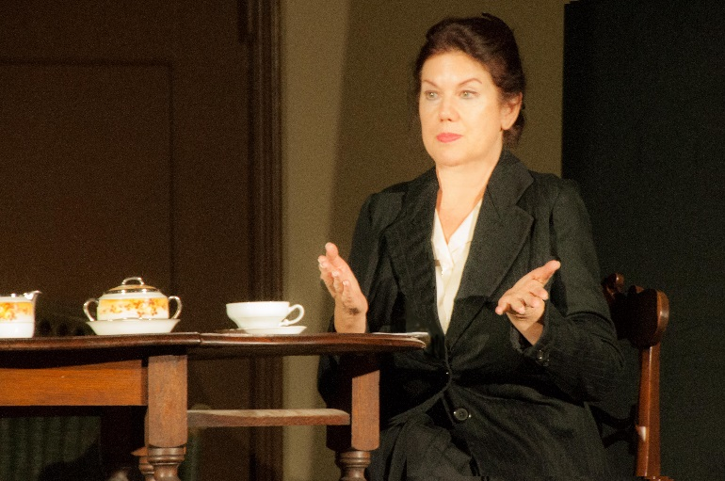
Scene vi a 1933
Julia meets Jerry Mac at a Tea Room, where he continues his interviewing and notes.
She enjoys sharing her ideas about architecture, making some points that seem to her self-evident And Jerry usually agrees.

Slide 29
Scene vi b 1924
Their father dies, and Avery, who has been his caregiver, is at such a loss, he contemplates suicide. Julia harshly berates him, saying he’d cause the family more pain.
But when she recognizes his suffering, she comforts him, advises his to take time to heal, then offers him the position of being her chauffeur.
They’ll spend time together again,
as they did in Paris.

Slide 30
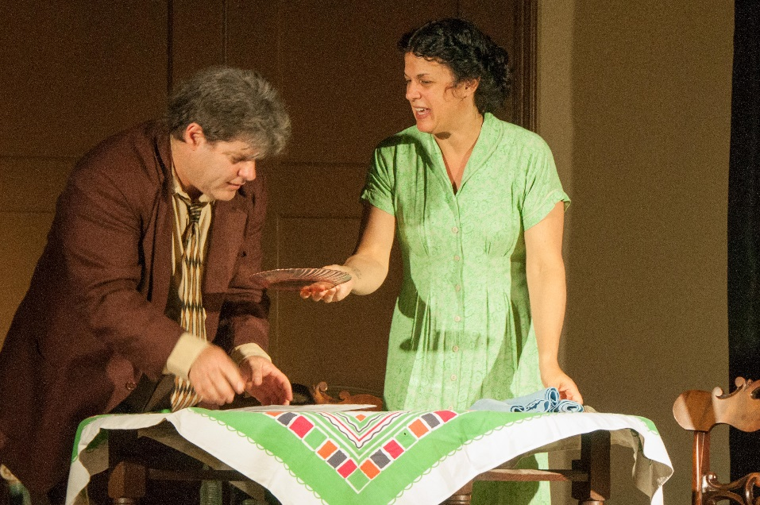
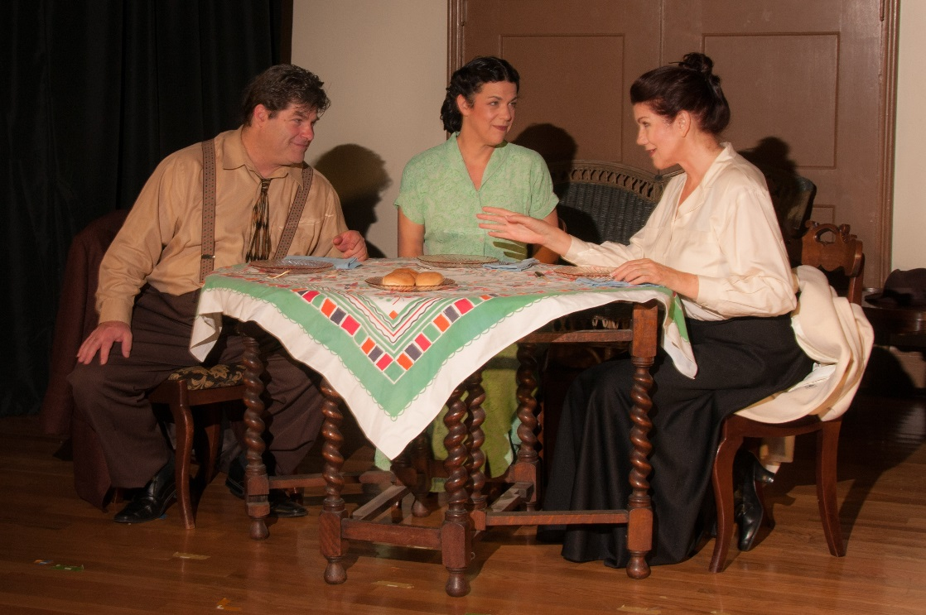
Scene vii 1933
Jerry & Irene
prepare to host
Julia at their home.
Julia shares stories with the Macs, enjoying her time with them. But all these stories are “off the record,” to Jerry’s dismay

Slide 31
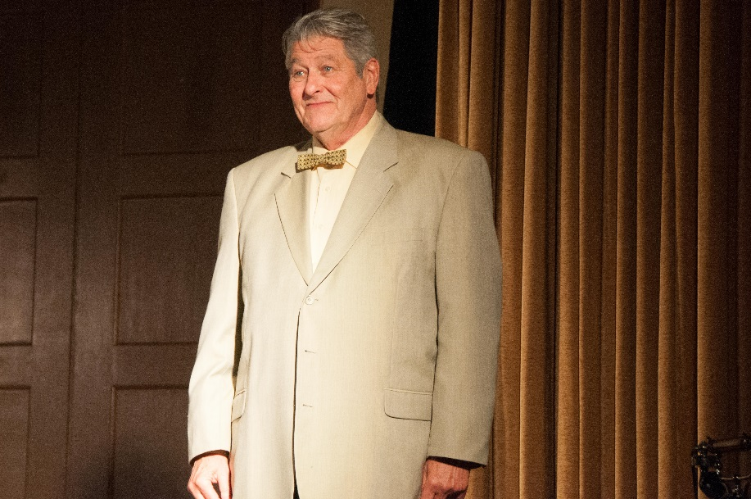
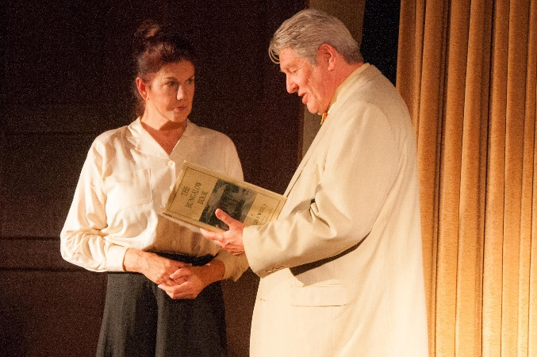
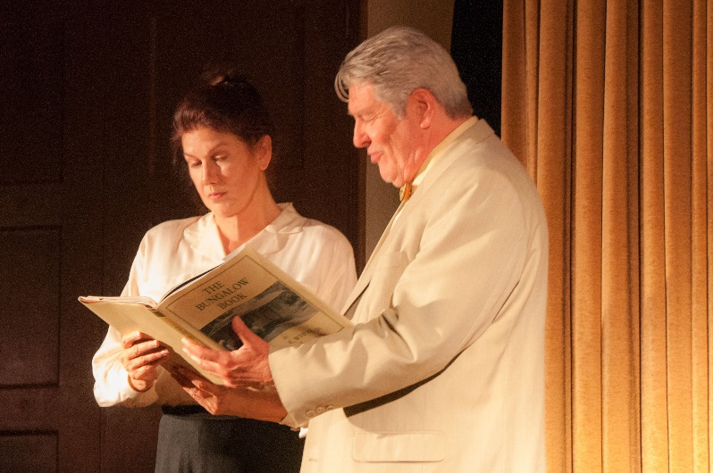
Scene vii b 1918
Following the death of his mother Phoebe Hearst, W.R. appears in Julia’s office to hire her. He wants “to build a little something at San Simeon.”
His first idea is to build a “Jappo-Swisso Bungalow”, so he brings Julia a “Bungolow Book.” She barely manages to conceal her skepticism that this is a good idea.

Slide 32
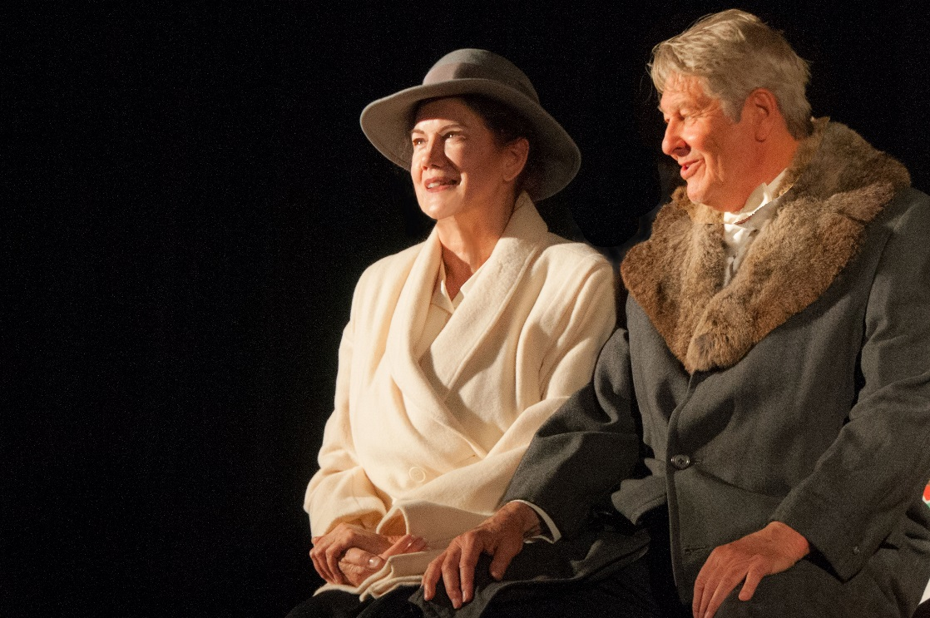
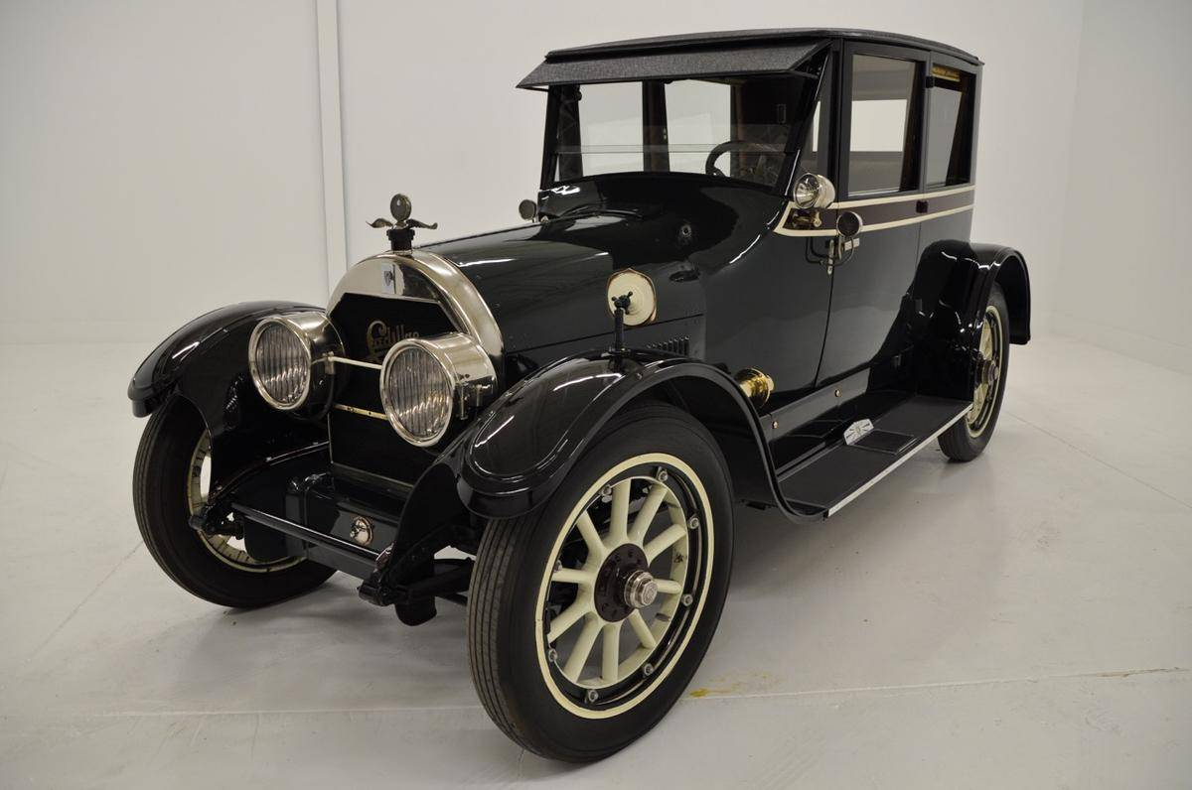
Scene vii c 1918
Hearst invites Julia
to ride in his fancy
Cadillac Touring Car
. . .to view his property,
“La Cuesta Encantada,”
the Enchanted Hill.
”Forget the Jappo-Swisso Bungalow,” she says.
“We should build a Spanish castle on this peak!”

Slide 33
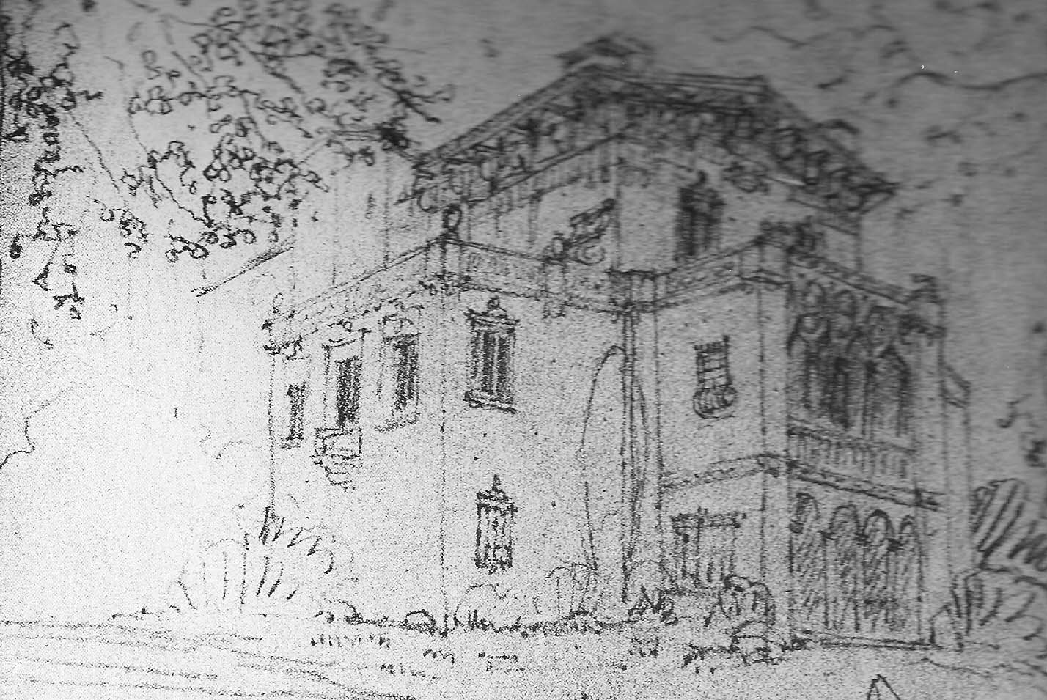
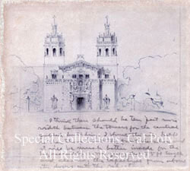
Scene vii c 1918
Hearst agrees. It’ll be a “Casa Grande”! And Julia gets to work designing . . .

Slide 34
Scene vii d 1928
At elegant Casa Grande, Hearst invites Julia to the dining table, and he and Marion welcome their celebrity guests.
But a small argument ignites when Julia declines tonight’s dessert, Willie’s favorite Peach Melba, and begins to smolder when he ties to force Julia to take a bite. . .
at which point she pushes his hand away, while Marion tries to convince Willie to leave her be.

Slide 35
Scene viii 1933
Following her dinner at Jerry & Irene Mac’s home, Julia calls Irene to encourage her to pursue her own career, and offers to help finance studies toward completing Irene’s library science degree.
Julia also shares that she must have an operation to remove her inner ear. Irene asks if they can help in any way. No, Julia says she’ll be fine.

Slide 36
Scene ix 19
On the eve of her dreaded surgery, Julia again dreams of her adversarial archetype, Janus, the Roman god of architecture who mocks her intellect, denigrates her work, undermines her confidence.
But the Roman goddess of the Hearth, Vesta, arrives to reassure Julia, remind her that her many architectural projects have honored women, and

Slide 37
Scene ix 1920s
Following her dinner at Jerry & Irene Mac’s home, Julia calls Irene to encourage her to pursue her own career, and offers to help finance studies toward completing Irene’s library science degree.

Slide 38
Scene xa 1920s
A painful recovery . . . Following her surgery, Julia returns to San Simeon, but must explain to Marion that she can’t attend Hearst’s dinner party, as an architect should not appear “asymmetrical”. Compassionate Marion says she’ll have dinner delivered to her room, with lots of coffee so Julia can resume her favorite activity: work!

Slide 39
Scene xb 1920s
As Julia recovers, she has another dream . . . Or vision . . .
Charlie Chaplain, a frequent San Simeon guest, appears, invites her to dance with him. As she does, she recovers her balance, her spirit, her symmetry, and resumes the life she loves.

Slide 40
Scene xii 1937
Hearst comes to Julia with disastrous financial news . . . But with more hopes and dreams than ever . . . She writes and draws the plans as fast as he can talk . . . And offers her sympathy for hopes deferred.

Slide 41
Scene xiii 1937
Worried, Jerry & Irene prepare for a visit from Julia.
She has said all along that Jerry’s book should focus on her work . . . But Jerry had never let go of his dream to write a full biography.
Though she appreciates his efforts . . .
Julia has come to tell him
their agreement is canceled. His book
must never be published.

Slide 42
Scene xiv 1960
Jerry Mac, who had so fervently desired to be Julia’s biographer, and his wife Irene, who thanks to Julia, became a librarian, had a son named Charlie.
Charlie is now the grandfather of Jenny, a student at Cal Poly
in San Luis Obispo.
Jenny listens avidly to Grandpa’s stories about Julia, and as Jenny reads from her great-great-grandfather’s notes, she begins to realize she wants to study architecture. . . .

Slide 43
Scene xiv 1960
Julia passed on in 1957,
but her legacy lives on in her buildings, as she always said it would.
The play concludes with details of The Monday Club, where this production was presented.
Julia stands on the very stage she designed and built,
silent now, but trusting in the message embedded in the structure.
Perhaps she haunts
The Monday Club
still. . . .

Slide 44
“The world to this mollusk looks exactly the same as always except in the process of living and growing, it creates a gorgeous mother of pearl legacy. One of nature’s truly astonishing designs.”
-- Julia Morgan

Slide 45
Rehearsal & Production Photographs
By Dennis Eamon Young
http://www.DennisEamonYoungPhoto.com

